Slide 1


Pole crimes

Slide 2
Objective:
We will employ PostgreSQL to query a comprehensive crime dataset, aiming to extract both quantitative and qualitative insights. These insights will assist investigative units, law enforcement agencies, and any institutions or companies interested in studying social phenomena for forensic sciences.
Dataset Overview:
Source: The dataset is provided by the British government.
Contents: It includes data related to crimes, phone records, individuals, and geographic areas specific to the city of Manchester during August 2017.
Analytical Framework: The data will be analyzed using the POLE (Person, Object, Location, Event) framework. This approach is intended to identify recurring patterns and potentially provide predictive deductions.
Potential Benefits:
Enhance forensic analysis capabilities.
Support crime prevention and resolution strategies.
Facilitate the understanding of complex social dynamics in urban environments.
The dataset can be accessed through this link: POLE Dataset

Slide 3
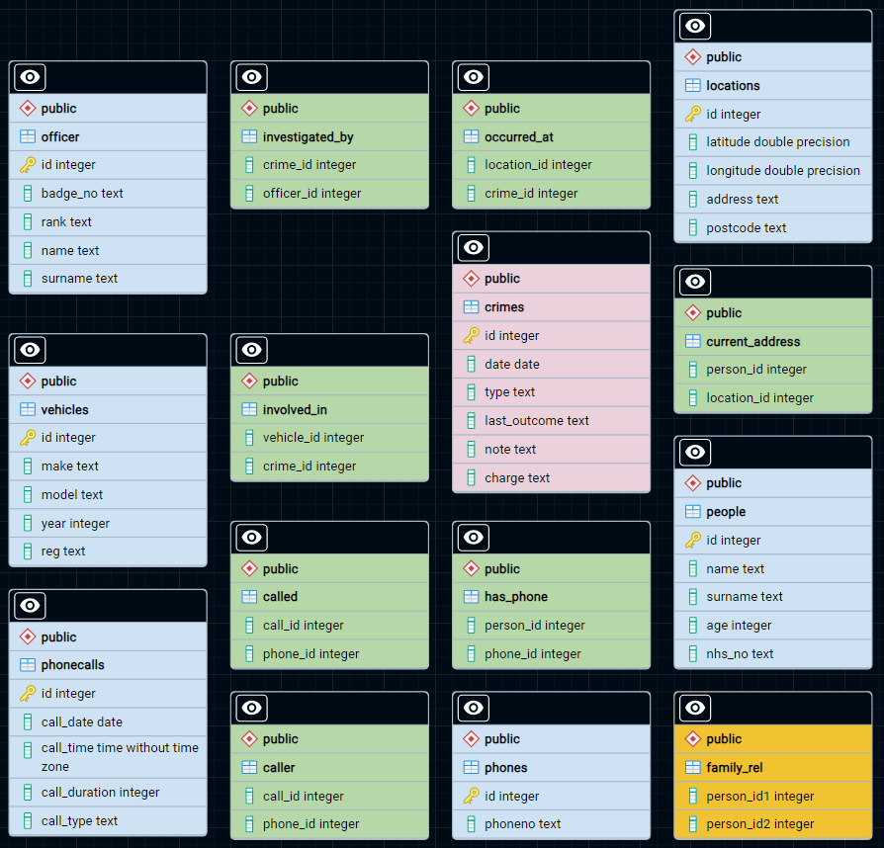
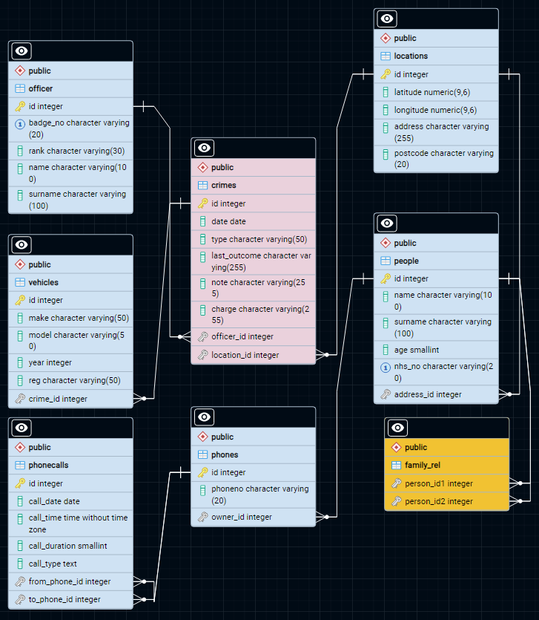
Original er schema
Optimized er schema

Slide 4
DB optimization steps
Change relational schema: removing some tables in order to create relations between entities (with foreign keys), normalizing the schema and reducing the number of needed joins.
New data types: using the correct data type for each attribute.
Procedures definition: deploying a cleaner and more reproducible project.
Indexes creation: allowing fast lookup and scanning of critical columns (primary keys).
Exploiting views: precomputing quantities of interest for the overall analysis and speeding-up the queries.
Adding constraints: providing more coherence to the schema.
Advantages
Scalability: {1, 4, 5}
Storage efficiency: {1, 2}
Less redundancy: {1, 3, 5}
Query readability: {1, 3, 5}
Reproducibility: {3, 5}
Fast computation: {1, 2, 4, 5}
Data integrity: {1, 2, 6}

Slide 5
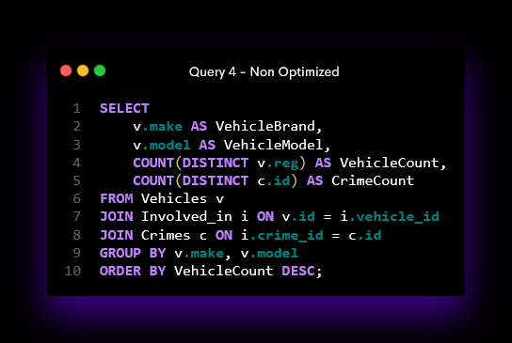
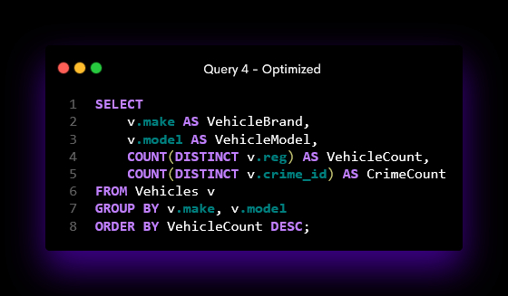
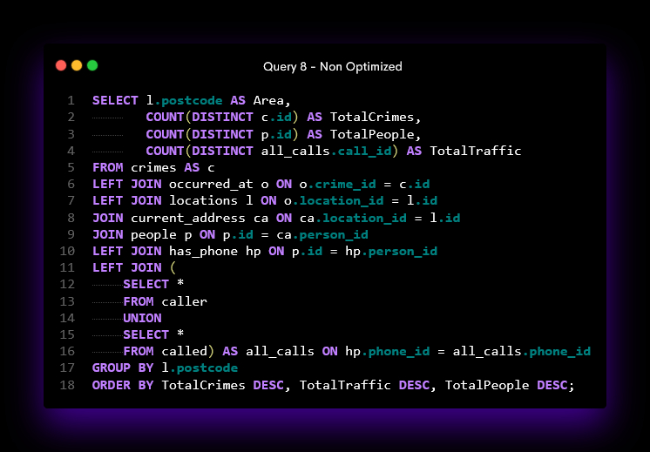
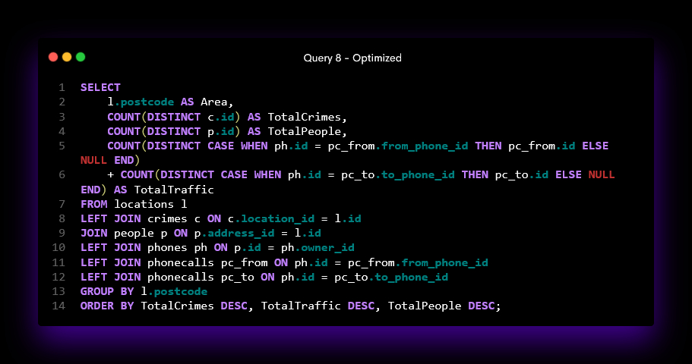
Examples of optimized queries

Slide 6
Data analysis – Query 1
Task:
Find police officers linked to over 30 unique crime investigations, and list these officers' surnames, badge numbers, and ranks, sorting the results alphabetically by surname.
Interpretation:
The intent is to find the busiest officers (who have several cases to solve) and identify any causal relationships with their seniority, sorting the results by badge number.
surname | badge_no | rank
Bagby | 00-6011813 | Sergeant
Loveridge | 01-0363085 | Inspector
Lumsdaine | 01-3764299 | Police Constable
Reilinger | 02-3468866 | Sergeant
Chesnut | 02-6192850 | Police Constable
Fonte | 03-1601856 | Sergeant
Assard | 03-2149839 | Police Constable
Tams | 03-5878006 | Inspector
Aykroyd | 03-6336692 | Police Constable
Ellwell | 03-6577521 | Police Constable
Query complete: Original 2.769 seconds / Optimized 0.341 seconds

Slide 7
Data analysis – Query 2
Task:
Identify crime hotspots by postcode, aggregating the number of crimes.
Interpretation:
By considering each area identified by a postcode, we pinpoint the most critical areas in terms of recorded criminal activity in the city, in order to then be able to propose an appropriate strategy for the deployment of anti-crime resources.
postcode | crimecount
M1 1LU | 166
M60 1TA | 111
M60 9AH | 48
M4 3AL | 46
M1 3LZ | 41
M90 2AY | 38
WN7 5SJ | 38
M4 2BS | 36
M3 1DA | 35
OL1 1QN | 35
Query complete: Original 0.146 seconds / Optimized 0.101 seconds

Slide 8
Data analysis – Query 3
Task:
Analyze the evolution of crime types over different areas it calculates the absolute daily change in crime counts from one day to the next instead of growth rates.
This change measures the volatility without considering the direction of the change (increase or decrease).
Interpretation:
By analyzing the volatility of the areas crime rate, we can identify areas for which we have a poor ability to predict criminal activity. Conversely, it is possible to analyze those areas for which the crime rate remains rather unchanged over time (whether low or high).
area | avg_daily_change
M1 1LU | 2.71
M60 1TA | 1.87
M1 3EZ | 1.4
WN7 5SJ | 1.35
M1 3LZ | 1.32
OL1 1QN | 1.26
OL6 8RT | 1.2
OL12 6TS | 1.13
M60 9AH | 1.08
M3 7JY | 1
Query complete: Original 0.278 seconds / Optimized 0.244 seconds

Slide 9
Data analysis – Query 4
Task:
Find the usage frequency for each vehicle type for the "vehicle crimes".
Interpretation:
We try to establish greater control over those types of vehicles that are generally more involved in crimes, perhaps because they are of particular interest to thieves or because they are suitable for carrying out criminal tasks such as drug dealing or robbery.
vehiclebrand | vehiclemodel | vehiclecount | crimecount
Ford | Mustang | 10 | 10
Pontiac | Bonneville | 9 | 9
Volkswagen | Passat | 8 | 8
Hyundai | Sonata | 8 | 8
Ford | E-Series | 7 | 7
Mercury | Grand Marquis | 7 | 7
Ford | Expedition | 7 | 7
Chrysler | Town & Country | 7 | 7
Pontiac | Grand Prix | 7 | 7
Nissan | Pathfinder | 6 | 6
Query complete: Original 0.216 seconds / Optimized 0.125 seconds

Slide 10
Data analysis – Query 5
Task:
For each type of crime type evaluate the standard deviation of the distance between the locations of the related crimes in order to understand if crimes are pretty concentrated or spread out in different areas of the city.
Also report the total number of areas involved in each type of crime.
Interpretation:
For each type of crime, it may be interesting to understand how uniformly the number of crimes is distributed over the urban area. We also report the number of areas involved so that the geographical extent (in terms of square footage) can be normalised by the number of areas over which it is defined.
crimetype | centroidlatitude | centroidlongitude | stdlatitude_km | stdlongitude_km | differentarea
Violence and sexual offences | 53.50694 | -2.27424 | 7.03 | 16.66 | 5515
Public order | 53.50586 | -2.27196 | 6.75 | 15.66 | 3427
Criminal damage and arson | 53.50518 | -2.27893 | 7.04 | 17.04 | 2864
Burglary | 53.50044 | -2.27709 | 7.47 | 17.31 | 2404
Vehicle crime | 53.49939 | -2.28067 | 7 | 17.19 | 2200
Other theft | 53.50037 | -2.27841 | 7 | 16.36 | 1694
Shoplifting | 53.502 | -2.27594 | 7.23 | 16.41 | 641
Other crime | 53.5132 | -2.29014 | 6.54 | 17.57 | 578
Robbery | 53.48915 | -2.2455 | 5.96 | 12.34 | 447
Bicycle theft | 53.4787 | -2.25895 | 6.11 | 12.43 | 355
Query complete: Original 0.363 seconds / Optimized 0.312 seconds

Slide 11
Data analysis – Query 6
Task:
Identify people that possibly had crime related phone calls.
This query, for a specific query crime, returns people that have had (as a caller or a called) a lot of calls with people that do not belong to their family (order by "No_fam_calls" counter), in the period of 10 days before the crime and that live in the same area (“post_code”) where the crime occurred.
Interpretation:
For a specific crime, we report a forensic analysis of the telephone traffic for people geographically linked to the crime.
In particular, we focus on calls in the days preceding the crime, made between individuals not belonging to the same family.
person | nhs_number | phone_number | no_fam_calls
Phillip Perry | 884-33-9676 | 0-(106)592-7420 | 4
Deborah Ford | 838-45-9343 | 5-(607)134-1574 | 3
Harry Lopez | 915-75-5600 | 1-(776)710-5989 | 2
Jonathan Hunt | 298-36-6290 | 2-(527)185-1019 | 2
Peter Bryant | 245-63-7539 | 6-(184)813-2011 | 1
Query complete: Original 0.108 seconds

Slide 12
Data analysis – Query 7
Task:
For each officer, return the number of cases to which it has been assigned which last_outcome="Under investigation" as "Num_unresolved", and the most frequent type of crime to which it has been assigned.
Order the result by "Num_unresolved“.
Interpretation:
When considering the assignment of new cases, it may be useful to analyze the officers by number of unsolved cases currently assigned and 'area of specialisation' (i.e. the most frequent type of crime they have worked on).
officerbadge | officerspecialization | totalnumunresolved
55-5623906 | Violence and sexual offences | 11
21-8583779 | Violence and sexual offences | 10
60-2236534 | Violence and sexual offences | 10
09-6971653 | Violence and sexual offences | 10
90-5774272 | Violence and sexual offences | 10
30-4157186 | Violence and sexual offences | 9
21-9479736 | Violence and sexual offences | 9
32-8274663 | Violence and sexual offences | 9
21-3341439 | Violence and sexual offences | 9
48-0216838 | Violence and sexual offences | 9
Query complete: Original 0.158 seconds / Optimized 0.129 seconds

Slide 13
Data analysis – Query 8
Task:
For a given query date, return the total number of crimes occurred on that day for each area (post_code), the total number of people living in each area end the total number of calls made by the inhabitants on that day.
Interpretation:
For each day in each area, we find patterns between crime levels, population density of the area and telephone traffic between inhabitants of the area.
area | totalcrimes | totalpeople | totaltraffic
M12 4GJ | 9 | 2 | 0
BL1 1LE | 8 | 1 | 4
SK5 8BZ | 6 | 3 | 18
SK1 4HU | 6 | 1 | 8
SK3 9EU | 6 | 1 | 8
BL3 5NJ | 6 | 2 | 4
OL8 2RB | 6 | 1 | 0
BL6 6RL | 5 | 1 | 8
M4 7EU | 5 | 2 | 4
M8 8YT | 5 | 2 | 4
Query complete: Original 0.135 seconds / Optimized 0.116 seconds

Slide 14
Data analysis – Query 9
Task:
For each Crime Type return the most common outcome, its frequency, the total number of cases and the percentage of the most common outcome over all the total cases.
Interpretation:
It might be interesting to analyze the legal outcome for each type of crime in order to identify any bias in the legal system itself.
crimetype | mostcommonoutcome | frequency | totalcases | percentage
Violence and sexual offences | Unable to prosecute suspect | 3263 | 8765 | 37.23
Public order | Investigation complete; no suspect identified | 2773 | 4839 | 57.31
Criminal damage and arson | Investigation complete; no suspect identified | 2681 | 3587 | 74.74
Burglary | Investigation complete; no suspect identified | 2468 | 2807 | 87.92
Vehicle crime | Investigation complete; no suspect identified | 2388 | 2598 | 91.92
Other theft | Investigation complete; no suspect identified | 1693 | 2140 | 79.11
Shoplifting | Investigation complete; no suspect identified | 873 | 1427 | 61.18
Other crime | Investigation complete; no suspect identified | 275 | 651 | 42.24
Query complete: Original 0.100 seconds / Optimized 0.085 seconds

Slide 15
Data analysis – Query 10
Task:
This query aggregates phone communication data for individuals, calculating metrics like the number of distinct phones per person, total and average call durations, total different calls, and the number of unique call days.
Interpretation:
The intent is to provide support to law enforcement agencies in analyzing telephone traffic for each individual, reporting on key factors such as the distribution of telephone traffic.
personid | numdistinctphones | totalcalltime | avgcallduration | totcalls | distinctcalldate
2 | 1 | 190 | 47.5 | 4 | 3
9 | 1 | 182 | 91 | 2 | 2
13 | 1 | 168 | 84 | 2 | 2
16 | 1 | 234 | 58.5 | 4 | 4
20 | 1 | 132 | 66 | 2 | 2
27 | 1 | 98 | 49 | 2 | 2
35 | 1 | 116 | 58 | 2 | 2
39 | 1 | 272 | 68 | 4 | 4
43 | 1 | 158 | 79 | 2 | 2
47 | 1 | 250 | 62.5 | 4 | 4
Query complete: Original 0.128 seconds

Slide 16



Thanks!
Enrico Grimaldi - 1884443
Mario Edoardo Pandolfo - 1835189
Engrima18
JRhin
Check-out our code!

